Slide 1
Module 2
Introduction to Active Directory Domain Services
Notes:
Presentation: 75 minutes
Lab: 50 minutes
After completing this module, students should be able to:
Describe the structure of Active Directory® Domain Services (AD DS).
Describe the purpose of domain controllers.
Install a domain controller.
Required Materials
To teach this module, you need the Microsoft® Office PowerPoint® file 20410D_02.pptx.
Important: We recommend that you use Office PowerPoint 2007 or a newer version to display the slides for this course. If you use PowerPoint Viewer or an earlier version of PowerPoint, all the features of the slides might not be displayed correctly.
Preparation Tasks
To prepare for this module:
Read all of the materials for this module.
Practice performing the demonstrations and the lab exercises.
Work through the Module Review and Takeaways section, and determine how you will use this section to reinforce student learning and promote knowledge transfer to on‑the‑job performance.
20410D
2: Introduction to Active Directory Domain Services

Slide 2
Module Overview
Overview of AD DS Overview of Domain Controllers Installing a Domain Controller
Notes:
20410D
2: Introduction to Active Directory Domain Services

Slide 3
Lesson 1: Overview of AD DS
Overview of AD DS What Are AD DS Domains? What Are OUs? What Is an AD DS Forest? What Is the AD DS Schema? What Is New for Windows Server 2012 Active Directory? What Is New for Windows Server 2012 R2 Active Directory?
Notes:
Do not spend too much time on each topic. Remember that this is a class on Windows Server® 2012, and not a class on AD DS.
20410D
2: Introduction to Active Directory Domain Services

Slide 4
Overview of AD DS
AD DS is composed of both logical and physical components
Logical components | Physical components
Partitions Schema Domains Domain trees Forests Sites OUs Containers | Domain controllers Data stores Global catalog servers RODCs
Notes:
Explain the logical and physical components that make-up AD DS. Provide brief descriptions of each.
20410D
2: Introduction to Active Directory Domain Services

Slide 5






What Are AD DS Domains?
AD DS requires one or more domain controllers
All domain controllers hold a copy of the domain database, which is continually synchronized
The domain is the context within which user accounts, computer accounts, and groups are created
The domain is a replication boundary
The domain is an administrative center for configuring and managing objects
Any domain controller can authenticate any sign-in
anywhere in the domain
The domain provides authorization
Users
AD DS
Computers
Groups
Notes:
Explain that a multimaster replication model means that every domain controller can make changes to most directory objects. Emphasize that the AD DS domain provides structure for managing users and computers.
20410D
2: Introduction to Active Directory Domain Services

Slide 6
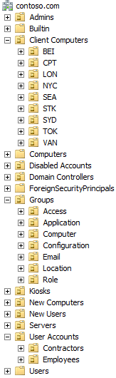
What Are OUs?
Containers that can be used to group objects within a domain
Create OUs to:
Configure objects by assigning GPOs
Delegate administrative permissions
OUs are represented by a folder with a book on it
Containers are represented by a blank folder
Notes:
Clearly establish for students the difference between OUs and containers: explain that containers are not OUs. Although containers can hold objects, they cannot have Group Policy Objects (GPOs) linked to them. Therefore, if you want to assign a GPO to an object, other than Domain level GPOs, it must be in an OU.
Be sure to point out the visual difference between an OU and a container: OUs are represented by a folder with a book on it, and containers are represented by a blank folder.
Explain to students that objects become orphaned most likely when an administrator on one domain controller deletes a container object, typically an OU, and an administrator on a different domain controller creates a child object, such as a user, in that container before the deletion has been replicated.
Remind students that the OU structure usually does not match the organizational chart, but is designed to support the delegation of administration, and should be a framework to support GPO linking. In a large organization, one with 50,000 users and computers, for example, it is much more manageable to divide those objects into OUs instead of trying to manage them in one very large unit.
Discuss some of the criteria that might drive the OU structure design, such as geographical location, department, object type, and cost center.
20410D
2: Introduction to Active Directory Domain Services

Slide 7





What Is an AD DS Forest?
Forest root
domain
Tree root
domain
adatum.com
fabrikam.com
atl.adatum.com
Child domain
Notes:
Use this slide to explain the relationships among the forest root domain, a child domain, and another tree. Emphasize that there is no administrative difference between the child domain and another tree, apart from the names.
20410D
2: Introduction to Active Directory Domain Services

Slide 8
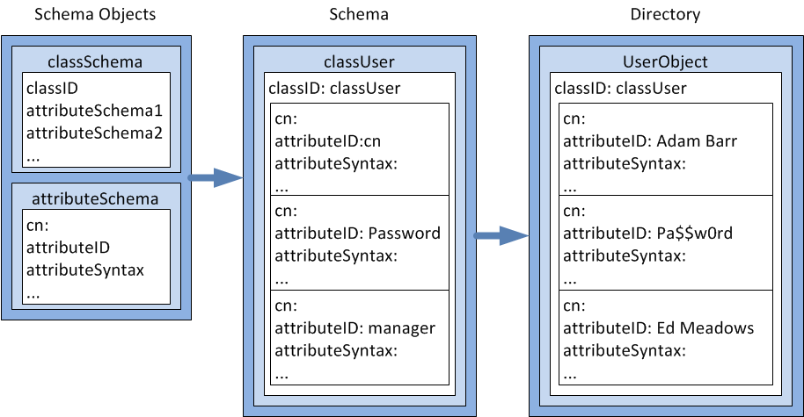
What Is the AD DS Schema?
The schema defines the objects that can be stored in AD DS
Notes:
Reinforce the concept that the schema defines the rules and syntax of the AD DS database, and provides the blueprint for the objects within it.
Optionally, you can demonstrate the Active Directory Schema snap-in to show how the objects are defined from attributes.
You also can show the hierarchy of objects and the inherited attributes. For example, the parent object for User is Organizational Person, the parent object for Organizational Person is Person, and the parent object for Person is an object called Top.
Point out that attributes are defined at each level in the hierarchy. This means that the User object contains all of the attributes that are defined on the User class, and all of the attributes defined farther up the objects hierarchy (Organizational Person, Person, Top).
20410D
2: Introduction to Active Directory Domain Services

Slide 9
What Is New for Windows Server 2012 Active Directory?
In Windows Server 2012 AD, it is easier to
Detect events such as a snapshot rollback
Install and configure cloned virtual machines
Prepare the system before installing or upgrading domain controllers
Use Windows PowerShell scripts to automate multiple AD DS installations
Control who can access resources
Recover objects from the Active Directory Recycle Bin
Use and manage the RID pool
Defer index creation
Notes:
Briefly review the points on the slide.
20410D
2: Introduction to Active Directory Domain Services

Slide 10
What Is New for Windows Server 2012 R2 Active Directory?
Improvements for using consumer devices
in the enterprise:
Workplace Join
Allows consumer devices to participate in the domain
Web Application Proxy
Allows applications to be published to the Internet
Multi-Factor Access Control
Allows claims using different factors
Multi-Factor Authentication
Allows you to specify the use of multiple factors for authentication
Notes:
Explain that these features are meant to address the growing trend toward workers bringing their own devices to the workplace.
20410D
2: Introduction to Active Directory Domain Services

Slide 11
Lesson 2: Overview of Domain Controllers
What Is a Domain Controller? What Is the Global Catalog? The AD DS Sign-in Process Demonstration: Viewing the SRV Records in DNS What Are Operations Masters?
Notes:
Provide a brief overview of the lesson contents.
20410D
2: Introduction to Active Directory Domain Services

Slide 12
What Is a Domain Controller?
Domain controllers
Servers that host the AD DS database (Ntds.dit) and SYSVOL
Kerberos authentication service and KDC services perform authentication
Best practices:
Availability:
At least two domain controllers in a domain
Security:
RODC and BitLocker
Notes:
Emphasize that the database and services are stored on servers called domain controllers.
Domain controllers—servers that perform the AD DS role—host the Active Directory database, SYSVOL, the Kerberos authentication service, and other Active Directory services. For redundancy purposes, it is best to have at least two available domain controllers.
Highlight that all domain controllers in a domain essentially are equal. Each domain controller contains a copy of the directory store, and updates can be made to the AD DS data on all domain controllers except for RODCs.
Emphasize the importance of having multiple domain controllers in each domain. This provides load balancing, but more importantly, it also provides recoverability if a server failure occurs.
Mention that all domain controllers engage in authentication and authorization, therefore the system has redundancy, with fewer fail points.
This topic does not provide much information about best practices. If students are interested, you can go into more detail about installing domain controllers in remote sites to protect against an unavailable wide area network (WAN) connection. You also can talk about increasing the number of domain controllers to account for redundancy and performance.
20410D
2: Introduction to Active Directory Domain Services

Slide 13





What Is the Global Catalog?
The global catalog:
Hosts a partial attribute set for other domains in the forest
Supports queries for objects throughout the forest
Schema
Configuration
Domain A
Schema
Configuration
Domain A
Schema
Domain B
Configuration
Global catalog server
Domain B
Schema
Configuration
Domain B
AD DS
Notes:
Describe the role of the global catalog server when searching for objects across domains in a forest. Define a global catalog as a domain controller that replicates the partial attribute set for each domain in the forest. The domain controller does not need the partial attribute set for its own domain because it already has the full copy of the domain database, and needs only the changes made to other domains. That is why, in a single-domain environment, making every domain controller a global catalog server adds no significant replication.
Question
Should a domain controller be a global catalog?
Answer
Global catalog placement affects how long a user’s sign-in takes. Therefore, global catalog placement must be planned carefully. In a single-domain environment, every domain controller should host the global catalog because every domain controller already holds a complete copy of the domain. In a multi‑domain scenario, you need to consider user sign-in times, program dependencies, global catalog high availability, and replication traffic when planning global catalog placement.
20410D
2: Introduction to Active Directory Domain Services

Slide 14


The AD DS Sign-in Process
The AD DS sign-in process:
The user account is authenticated to the domain controller.
The domain controller returns a TGT back to client.
The client uses TGT to apply for access to the workstation.
The domain controller grants access to the workstation.
The client uses TGT to apply for access to the server.
The domain controller returns access to the server.
Domain controller
Workstation
Server
Notes:
Use this slide to illustrate how the sign‑in process works.
In the first phase, the user account is authenticated to the domain controller.
In the second phase, the user account applies to the domain controller for a ticket to gain authorization to connect with the local computer.
A centralized directory service such as AD DS provides a single identity store, authentication service, and point of management for administration.
Emphasize the advantages of a single identity store for security and manageability.
Review the following information to prepare for this topic:
Security Identifiers Technical Reference:
http://go.microsoft.com/fwlink/?LinkID=331090
Well-known security identifiers in Windows operating systems:
http://go.microsoft.com/fwlink/?LinkID=331085
20410D
2: Introduction to Active Directory Domain Services

Slide 15
Demonstration: Viewing the SRV Records in DNS
In this demonstration, you will see how to use DNS Manager to view SRV records
Notes:
Demonstrate the SRV records in DNS briefly, or as appropriate for the level of student experience or interest.
After showing the sub‑domains that start with an underscore, explain that domain controllers register several SRV records so that you can search them in multiple ways. Look for an SRV record in _tcp.Default‑First‑Site‑Name._sites.adatum.com that is offering the Kerberos authentication service. Examine the record, and show that server LON‑DC1.adatum.com is offering the Kerberos authentication service over TCP port 88, and that the server is answering for the site Default‑First‑Site‑Name. This is the preferred domain controller to connect to because the domain controller is in the same AD DS site as the client computer.
Point out that, because domain controllers register SRV records in many different ways, you can find an alternative if the preferred domain controller is not available. Alternatively, you could go to C:\windows\system32\config, open netlogon.dns with Notepad, and show all of the SRV records that each domain controller will register in DNS.
Note that SRV records are registered in DNS by the Net Logon service that is running on each domain controller. If the SRV records are not entered in DNS correctly, you can trigger the domain controller to reregister those records by restarting the Net Logon service on that domain controller. This reregisters only the SRV records. If you want to reregister the host record information in DNS, you must run ipconfig /registerdns from the command prompt, just as you would for any other computer.
Preparation Steps
Start the 20410D‑LON‑DC1 virtual machine.
Demonstration Steps
View the SRV records by using DNS Manager
On LON‑DC1, sign in with the user account Adatum\Administrator and the password Pa$$w0rd.
In Server Manager, click the Tools menu.
20410D
2: Introduction to Active Directory Domain Services
(More notes on the next slide)

Slide 16
Notes:
In the Tools list, click DNS.
In the DNS Manager window, in the tree menu, go to LON‑DC1\Forward Lookup Zones\adatum.com. Show the following four DNS subzones:
_msdcs
_sites
_tcp
_udp
Expand Forward Lookup Zones, expand adatum.com, expand _sites, expand Default‑First‑Site‑Name, expand _tcp, and then, in the right pane, show the following record: _ldap Service Location (SRV) [0][100][389] lon‑dc1.adatum.com.
If students have sufficient expertise and interest, open c:\windows\system32\config, and then open the netlogon.dns file in Notepad.
Show all the SRV records that this domain controller will register in DNS.
After you complete the demonstration, revert the virtual machine.
20410D
2: Introduction to Active Directory Domain Services

Slide 17
What Are Operations Masters?
In the multi-master replication model, some operations must be single master
Many terms are used for single master operations in AD DS, including:
Operations master (or operations master roles)
Single master roles
Flexible single master operations (FSMOs)
The five FSMOs are:
Forest:
Domain naming master
Schema master
Domain:
RID master
Infrastructure master
PDC Emulator master
Notes:
Discuss each operations master role in as much depth as you think is appropriate for students.
Be sure to point out that most master roles are so specific that the master could be offline for a while without causing any problems. For example, you do not need the schema master until you make changes to the schema, and you do not need the domain naming master until you add or remove a domain in the forest.
Point out that other domain services may be slow or disrupted if a domain controller is offline and not available. Be sure to point out that these roles all run on a domain controller, so the loss of a domain controller could cause serious problems.
Domain operations master roles are needed on a more regular basis than those in the forest root domain, particularly the primary domain controller (PDC) emulator.
The RID master provides a pool of RIDs to each domain controller. If this master is not available, eventually a domain controller will attempt to create an account and will be unable to do so.
Describe the three PDC functions to the level of detail that is provided in the student handbook. Enforce that if the PDC emulator master is not available or is slow to respond, you are more likely to have issues in the domain.
You can find which domain controllers are operations master holders by using the following command:
netdom query fsmo
Review the following article, "Operations master roles," to prepare for this topic:
http://go.microsoft.com/fwlink/?LinkID=266738
20410D
2: Introduction to Active Directory Domain Services

Slide 18
Lesson 3: Installing a Domain Controller
Installing a Domain Controller from Server Manager Installing a Domain Controller on a Server Core Installation of Windows Server 2012 Upgrading a Domain Controller Installing a Domain Controller by Using Install from Media What Is Windows Azure Active Directory? Deploying Domain Controllers in Windows Azure
Notes:
Depending on students’ experience with AD DS, you might have to explain in more detail the implications of starting the Active Directory Domain Services Installation Wizard from Server Manager and not by using the dcpromo tool.
You used to be able to start the Active Directory Installation Wizard by using dcpromo, but in Windows Server 2012 this tool is used only for an unattended installation while IT departments migrate their processes to Windows PowerShell®.
Mention to students that you can promote a server to be a domain controller remotely by using Server Manager running on Windows Server 2012.
20410D
2: Introduction to Active Directory Domain Services

Slide 19
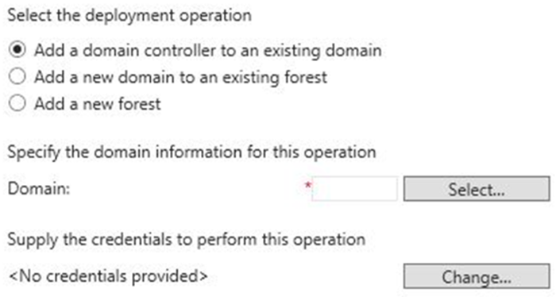
Installing a Domain Controller from Server Manager
Deployment Configuration section of the
Active Directory Domain Services Configuration Wizard
Notes:
Use Server Manager to describe the initial process of installing an AD DS domain controller. Explain that the Active Directory Domain Services Installation Wizard has been depreciated. However, you still can run the command, dcpromo, with an answer file and that this functionality was retained to allow companies that use automation to convert to Windows PowerShell deployments. Explain that the initial pass installs the files for AD DS, and then you can continue to configure the AD DS installation.
20410D
2: Introduction to Active Directory Domain Services

Slide 20
Installing a Domain Controller on a Server Core Installation of Windows Server 2012
Installing AD DS is a two-step process regardless of which installation method you use
Method 1, use Server Manager on a Windows 2012 server with a GUI interface to connect to the system
Install the files by installing the
Active Directory Domain Services role
Install the domain controller role by running the Active Directory Domain Services Configuration Wizard
Method 2, Use Windows PowerShell locally, or remotely using WinRM
Install the files by running the command Install-WindowsFeature AD-Domain-Services
Install the domain controller role by running the command Install-ADDSDomainController
Notes:
Explain the supported methods for installing the domain controller role on Windows Server 2012 servers remotely.
Refer to the links on the following web page to prepare for this topic:
AD DS Deployment Cmdlets in Windows PowerShell, at http://go.microsoft.com/fwlink/?LinkID=331089
20410D
2: Introduction to Active Directory Domain Services

Slide 21


Upgrading a Domain Controller
Options to upgrade AD DS to Windows Server 2012:
In-place upgrade from Windows Server 2008 to Windows Server 2012
Benefit: Except for the prerequisite checks, all the files and programs stay in place and there is no additional work required
Risk: May leave legacy files and DLLs
Introduce a new Windows Server 2012 server into the domain and promote it to be a domain controller
This option is usually preferable
Benefit: The new server has no accumulated legacy files and settings
Risk: May need additional work to migrate administrators’ files and settings
Notes:
Describe the different methods for upgrading a forest and domain, and discuss the risks and benefits of each method.
Explain that the process is the same whether you upgrade from Windows Server 2008 or Windows Server 2008 R2 to Windows Server 2012 or Windows Server 2012 R2.
The process is also the same when you upgrade from Windows Server 2012 to Windows Server 2012 R2.
20410D
2: Introduction to Active Directory Domain Services

Slide 22
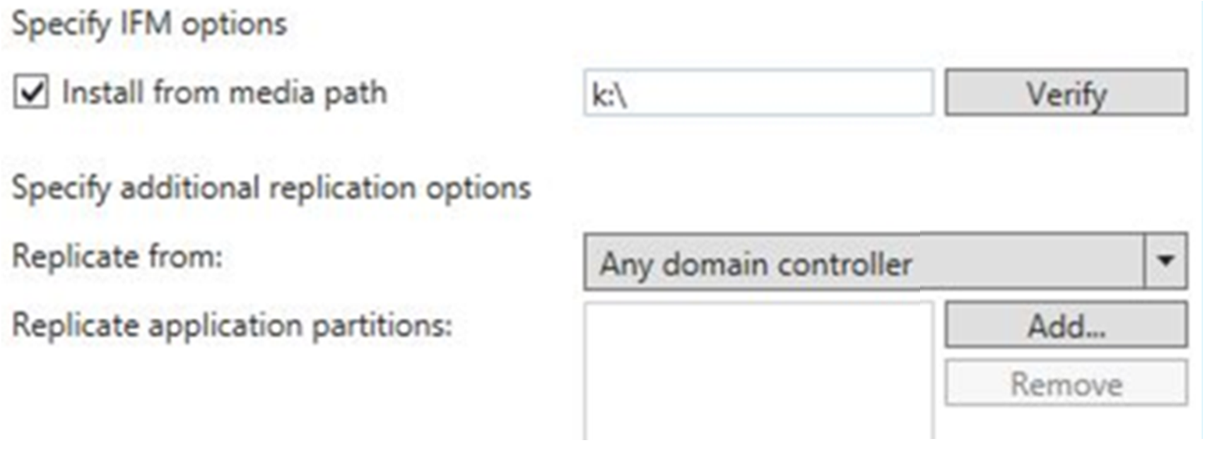
Installing a Domain Controller by Using Install from Media
Install from Media section on the Additional Options page of the Active Directory Domain Services Configuration Wizard
Notes:
Point out to students that because they are installing the domain controller by using the IFM method, they should select the Install from media path check box. Then they type the path to the snapshot file into the Install From Media Path box.
20410D
2: Introduction to Active Directory Domain Services

Slide 23


What Is Windows Azure Active Directory?
Exchange Online
SharePoint Online
Lync Online
Office 365
Windows Azure Active Directory
Internet
Windows Azure Apps
Synchronize
On-premises
AD DS
Internet connected apps
Notes:
Provide students with an overview of Windows Azure Active Directory (Windows Azure AD). Stress that this does not replace an on-premises AD DS solution, but instead provides identity management for cloud-based applications. Explain that Windows Azure AD is hosted on Microsoft hardware, and that subscribers are responsible for managing only their users, not the underlying software or hardware.
Review the following website to prepare for this topic:
Active Directory, http://go.microsoft.com/fwlink/?LinkID=331091
20410D
2: Introduction to Active Directory Domain Services

Slide 24
Deploying Domain Controllers in Windows Azure
Windows Server 2012 is cloud-ready and virtualization safe
Considerations for deploying in Windows Azure include:
Rollback
Resource limitations
Virtualization considerations for deploying AD DS
Time synchronization
Single point of failure
Notes:
Explain that deploying Windows Server 2012 Active Directory in Windows Azure is not the same as using Windows Azure AD. Explain that potential issues with deploying AD DS in the cloud are addressed in Windows Server 2012.
20410D
2: Introduction to Active Directory Domain Services

Slide 25
Lab: Installing Domain Controllers
Exercise 1: Installing a Domain Controller Exercise 2: Installing a Domain Controller by Using IFM
Logon Information
Virtual machines 20410D‑LON‑DC1
20410D‑LON‑SVR1
20410D‑LON‑RTR
20410D‑LON‑SVR2
User name Adatum\Administrator
Password Pa$$w0rd
Estimated Time: 50 minutes
Notes:
Before students begin the lab, read the lab scenario and display the next slide. Before each exercise, read the scenario associated with the exercise to the class. The scenarios give context to the lab and exercises, and help to facilitate the discussion at the end of the lab. Remind students to complete the discussion questions after the last lab exercise.
Exercise 1: Installing a Domain Controller
Users are experiencing slow sign-ins in London during peak use times. The server team has determined that the domain controllers are overwhelmed when many users authenticate simultaneously. To improve sign-in performance, you will add a new domain controller in the London data center.
Exercise 2: Installing a Domain Controller by Using IFM
Your manager has assigned you to manage one of the new branch offices that are being configured. A faster network connection will be installed in a few weeks. Until then, network connectivity will be very slow.
The branch office requires a domain controller to support local sign‑ins. To avoid problems with the slow network connection, you will use IFM to install the domain controller in the branch office.
Instructor Note: Once the domain controller is established by using the IFM media, when it reboots it connects to other domain controllers and receives any updates and changes that occurred since the IFM backup was created.
20410D
2: Introduction to Active Directory Domain Services

Slide 26
Lab Scenario
Your manager has asked you to install a new domain controller in the datacenter to improve sign-in performance and to create a new domain controller for a branch office by using IFM
Notes:
20410D
2: Introduction to Active Directory Domain Services

Slide 27
Lab Review
Why did you use Server Manager and not dcpromo when you promoted a server to be a domain controller? What are the three operations masters found in each domain? What are the two operations masters that are present in a forest? What is the benefit of performing an IFM install of a domain controller?
Notes:
Lab Review Questions
Question
Why did you use Server Manager and not dcpromo when you promoted a server to be a domain controller?
Answer
In Windows Server 2012, the dcpromo tool is deprecated and its uses are limited. It is used only at a command prompt, for example, to perform an unattended installation of AD DS, or to do a complete domain controller promotion from a command-line interface. Although Server Manager is the preferred tool to use to promote a server, you also can use Windows PowerShell or another type of scripted procedure.
Question
What are the three operations masters found in each domain?
Answer
The three operations masters are:
RID master
Infrastructure master
PDC emulator masters
Question
What are the two operations masters that are present in a forest?
Answer
The two operations masters that are present in a forest are the schema master and the domain naming master.
Question
What is the benefit of performing an IFM install of a domain controller?
Answer
When you have an unreliable wide area network (WAN) link, performing an IFM install reduces the use of the WAN link and provides for a more reliable installation process
20410D
2: Introduction to Active Directory Domain Services

Slide 28
Module Review and Takeaways
Review Questions
Notes:
Module Review Questions
Point students to the appropriate section in the course so that they are able to answer the questions that this section presents.
Question
What are the two main purposes of OUs?
Answer
The two main purposes of OUs are to provide a framework for delegations of administration and to provide a structure to enable the targeted GPO deployment.
Question
Why would you need to deploy an additional tree in the AD DS forest?
Answer
You would deploy an additional tree in the AD DS forest if you needed more than one DNS namespace.
Question
Which deployment method would you use if you had to install an additional domain controller in a remote location that had a limited WAN connection?
Answer
You would use the IFM option, because it eliminates the need to copy the entire AD DS database over the WAN link.
Question
If you needed to promote a Server Core installation of Windows Server 2012 to be a domain controller, which tool or tools could you use?
Answer
To promote a Server Core installation of Windows Server 2012 to a domain controller, you could use the following tools:
Server Manager, which allows you to install AD DS remotely
Windows PowerShell 4.0
The command dcpromo /unattend, run on the Server Core server
20410D
2: Introduction to Active Directory Domain Services
(More notes on the next slide)

Slide 29
Notes:
Question
If you wish to run a Domain Controller in the cloud, which service should you consider using, Windows Azure AD or Windows Azure IaaS virtual machines?
Answer
Answers will vary depending on student’s needs. Windows Azure AD is designed to provide identity and access management for web-based applications. Using Windows Azure IaaS allows you to deploy a full-featured Active Directory domain controller.
20410D
2: Introduction to Active Directory Domain Services

